Slide 1



CustomPro: Network Protocol Customization through Cross-host Feature Analysis
Yurong Chen, Tian Lan, Guru Venkataramani
Securecomm 2019

Slide 2
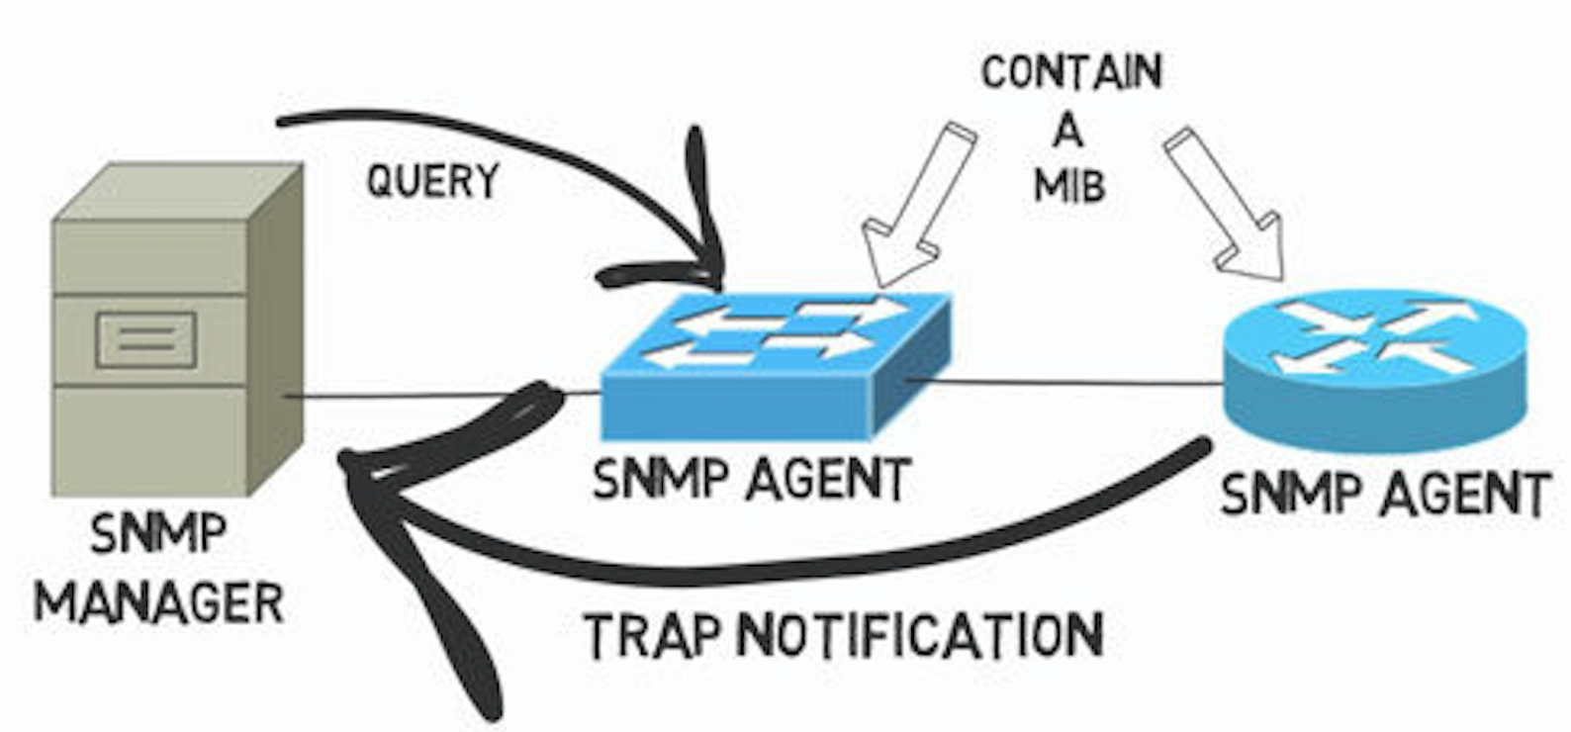

Network protocols are bloated and vulnerable
OpenSSL: Heartbeat
SNMP: Trap communication

Slide 3

Program Customization
Yufei Jiang, Dinghao Wu, and Peng Liu. "JRed:Program Customization and Bloatware Mitigation Based on Static Analysis."
Yufei Jiang, Can Zhang, Dinghao Wu, and Peng Liu. "Feature-Based Software Customization: Preliminary Analysis, Formalization, and Methods.”
Guoqing Xu, Nick Mitchell, Matthew Arnold, Atanas Rountev, and Gary Sevitsky. "Software bloat analysis: finding, removing, and preventing performance problems in modern large-scale object-oriented applications."
if(!accepted){
drink();}
else sleep();
Static Analysis

Slide 4


Program Customization
mov %eax,-0x10(%ebp)
xor %eax,%eax
cmpl $0x2,(%ecx)
je 80488aa
Zeng, J., Fu, Y., Miller, K. A., Lin, Z., Zhang, X., & Xu, D.. “Obfuscation resilient binary code reuse through trace-oriented programming. “
Kwon, Y., Wang, W., Zheng, Y., Zhang, X., & Xu, D.. “CPR: cross platform binary code reuse via platform independent trace program. “
Kim, D., Sumner, W. N., Zhang, X., Xu, D., & Agrawal, H.. Reuse-oriented reverse engineering of functional components from x86 binaries.
…
…
movl $0x0,0x4(%esp)
lea -0x20(%ebp),%eax
mov %eax,(%esp)
call 8048618
mov 0x804a04c,%eax
mov %eax,0xc(%esp)
call 8048628
Execution Traces

Slide 5

Issues remaining…
Program functions are hard to identify when source code is unavailable
Customization purely depending on inputs lacks scalability (cannot process inputs other than known testcases)

Slide 6
Goal of Design
Ideas
Works without understanding of detailed program implementation
Recognize program feature by packet tainting
Produce binaries that can process new inputs,
Explore program code by symbolic execution,
Works with program binary directly
Static binary rewriting
Custom-
Pro!

Slide 7
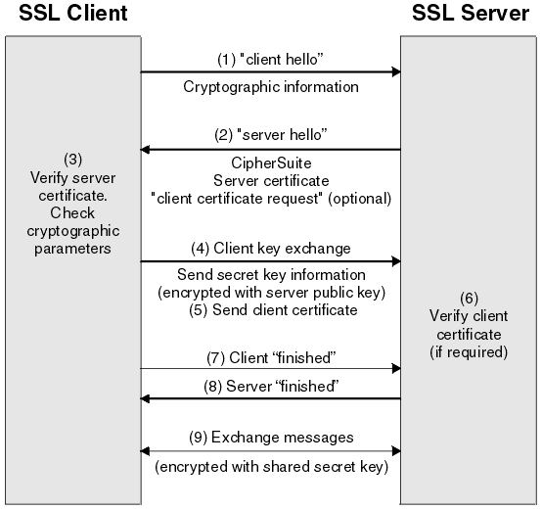
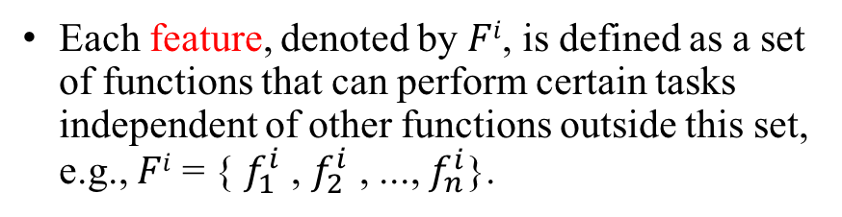
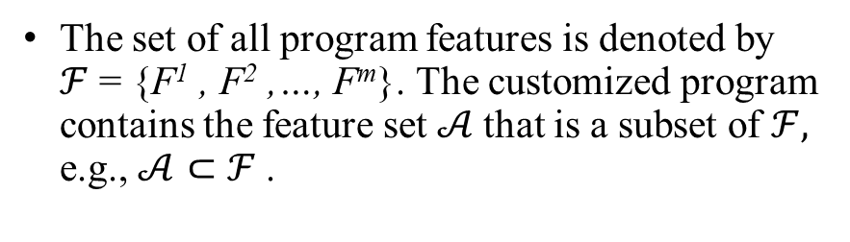
Definitions
Each feature, denoted by $Fi$, is defined as a set of functions that can perform certain tasks independent of other functions outside this set, e.g., $Fi$ = { $f_{1}^{i}$ , $f_{2}^{i}$ , ..., $f_{n}^{i}$}.
The set of all program features is denoted by $ℱ$ = {F¹ , F² ,…, F^{m}}. The customized program contains the feature set $𝒜$that is a subset of $ℱ,$ e.g., $𝒜⊂$ $ℱ$.
Removable Features:
Client certificate
Heartbeat
Examples
(from OpenSSL)

Slide 8
System Overview

Slide 9
Example
Tainted Packet
mov %eax,-0x10(%ebp)
xor %eax,%eax
cmpl $0x2,(%ecx)
je 80488aa
movl $0x0,0x4(%esp)
lea -0x20(%ebp),%eax
mov %eax,(%esp)
call 8048618
1
4
mov 0x804a04c,%eax
xor %eax,0xc(%esp)
movl $0x17,0x8(%esp)
movl $0x1,0x4(%esp)
movl $0x8048cb8,(%esp)
jne 80488fd
1
mov 0x804a04c,%eax
mov %eax,0xc(%esp)
call 8048628
2
5
2
6
6
movl $0x8048d00,(%esp)
call 8048648
movl $0x0,0x8(%esp)
movl $0x1,0x4(%esp)
movl $0x2,(%esp)
call 8048959
3
5
3
7
7
mov $0x8048d38,(%esp)
call 8048959
4

Slide 10
Feature Identification
Execution tracing and tainting
Run the programs in TEMU (a whole system emulator), logging instructions as well as other runtime information such as register states.
Instrument the tracecap plugin to enable: multi-tag field tainting
Taint-guided symbolic execution
Angr: explore(avoid, find)

Slide 11

Multi-tag field tainting
mov %eax,-0x10(%ebp)
xor %eax,%eax
cmpl $0x2,(%ecx)
je 80488aa
Feature 1
movl $0x0,0x4(%esp)
lea -0x20(%ebp),%eax
mov %eax,(%esp)
mov 0x804a04c,%eax
xor %eax,0xc(%esp)
movl $0x17,0x8(%esp)
movl $0x1,0x4(%esp)
movl $0x8048cb8,(%esp)
jne 80488fd
Mem
Feature 2
call 8048618
movl $0x8048d00,(%esp)
call 8048959

Slide 12
Taint-guided SE
Dynamic Tracing/Tainting:
Limited scope
Symbolic execution:
Path explosion
… … … … …

Slide 13
Feature Customization
Instruction identification
Binary rewriting
Verification

Slide 14
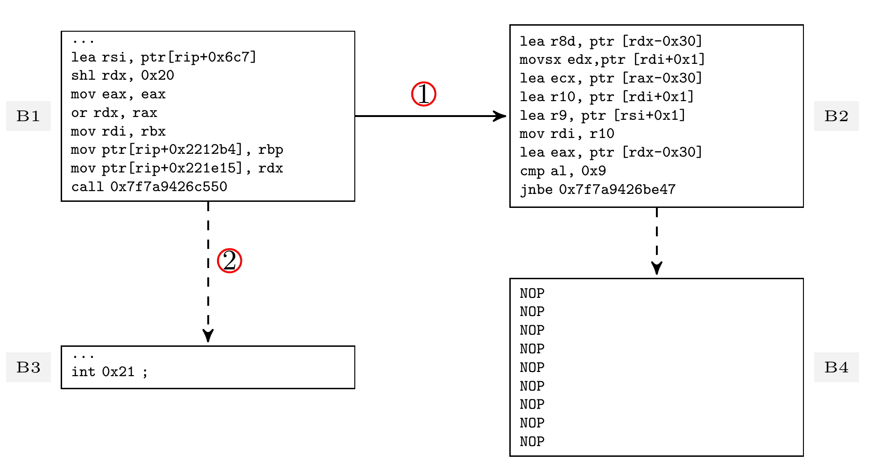
Binary rewriting
Call site: if undesired basic blocks are invoked through jump or call, change the calling instructions to exit (interruption)
Callee: change all instructions to NOPs.

Slide 15
Verification and feedbacks
Generate testcases by feature categories: fix feature-critical fields and fuzz others
If “benign” inputs result in crashes, feed such inputs to normal program and compare the execution traces to find out the root cause, and redo feature identification and rewriting; similar for “buggy” inputs
Multiple iterations

Slide 16
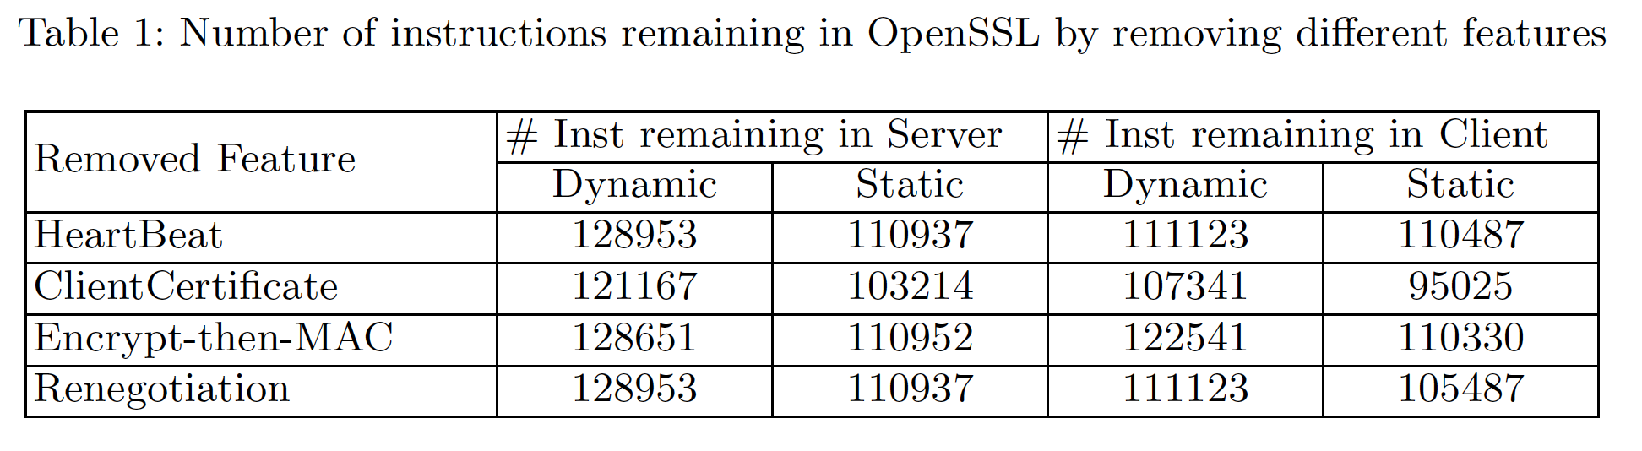
Evaluation
Original binaries: s_server: 130212/111595, s_client: 124151/11123
OpenSSL

Slide 17
Limitations & Future work
CustomPro does not work with encrypted/obfuscated binaries
Backward tainting: find the instructions that generate the first packet

Slide 18

Thank you!
N00014-17-1-2786 & N00014-15-1-2210

